Slide 1
Problem Statement
Students need personalised learning paths that adapt to their individual performance and learning needs.

Slide 2
BACHELOR OF TECHNOLOGY IN
COMPUTER SCIENCE & ENGINEERING
Under the Guidance of
Supervisor Name: Prof. (Dr.) Vijay Singh
Project Team ID: MP2026CSE279
Submitted By
Name of Student1: Shashi Pandey(Team Lead)
Enrollment No.: GEU-232023609
Name of Student2: Rudransh Nautiyal
Enrollment No.: GEU-232023578

Slide 3
Introducing
Traditional learning often follows a fixed approach, making it difficult to address each student's individual learning pace, strengths, and weaknesses.

Slide 4
Target Audience
Secondary Education-NCERT
Primary Focus Class 10

Slide 5

Proposed Solution
Same syllabus, different learning paths based on individual student performance.
Select Topic
Micro-lesson
Personalized Next Steps
Adaptive Quiz

Slide 6





Key Features
Animated Micro-Learning Videos
Adaptive Difficulty
Personalized Recommendations
Question complexity changes according to student performance
Short, topic-specific lessons for better engagement
Suggests revision, practice or the next topic
AI Tutor
Performance Analysis
Provides explanations and learning guidance according to student needs
Identifies strengths, weaknesses, accuracy and topic mastery

Slide 7
System Architecture
Technology Stack
Frontend
Backend / Database
AI / ML
Swift, SwiftUI
Supabase + PostgreSQL
Python, Scikit-learn / XGBoost
AI Tutor
Video
Version Control
LLM API
Animated micro-learning content
Git & GitHub

Slide 8
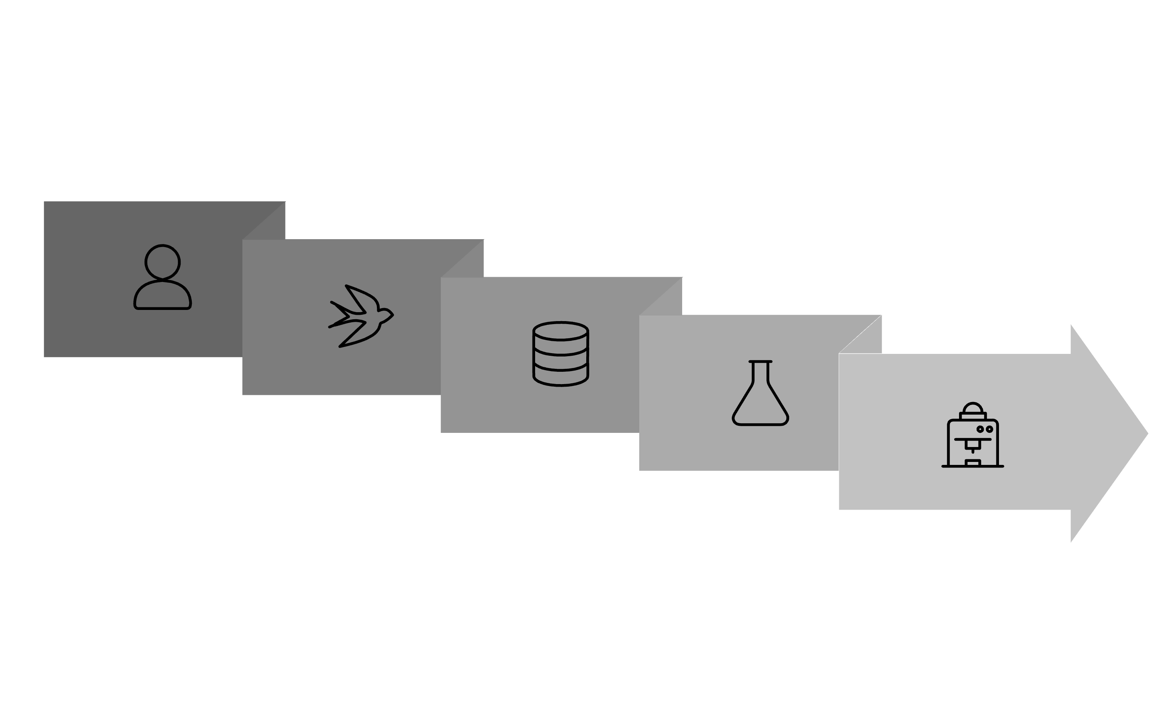
Data Flow
Student
Supabase
AI/ML Engine
iOS App
Python API

